Slide 1
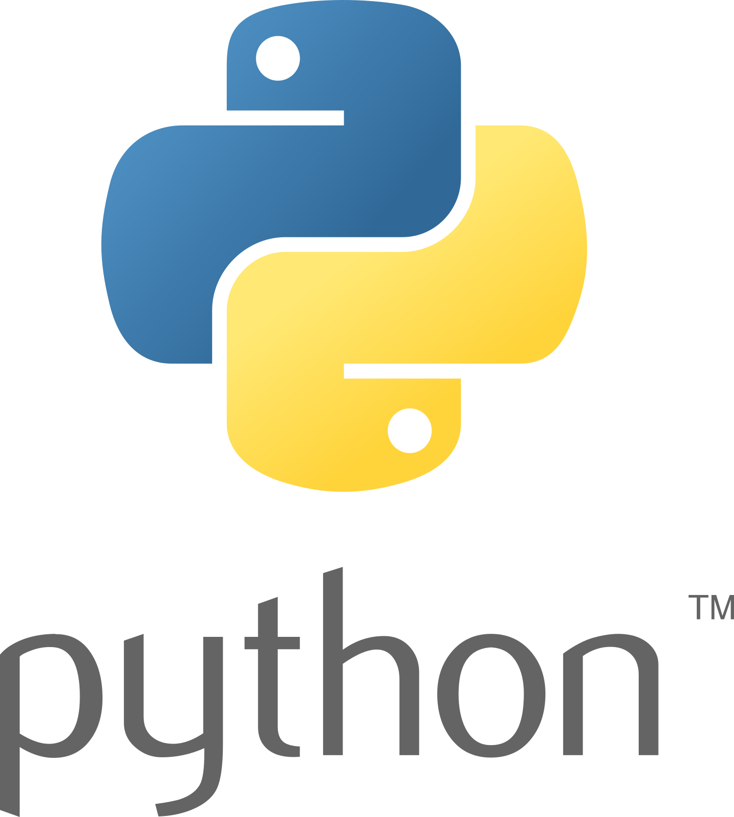
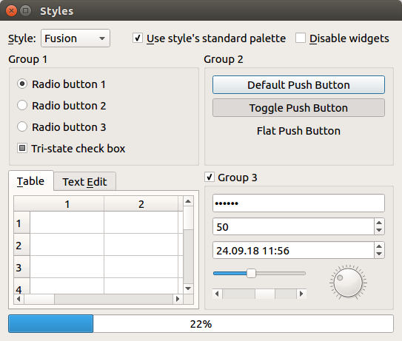
User Interfaces with Python (Tkinter)
11/12/2020

Slide 2
Getting Set Up
Install link: https://www.python.org/
Make sure to select “Add to system PATH”

Slide 3
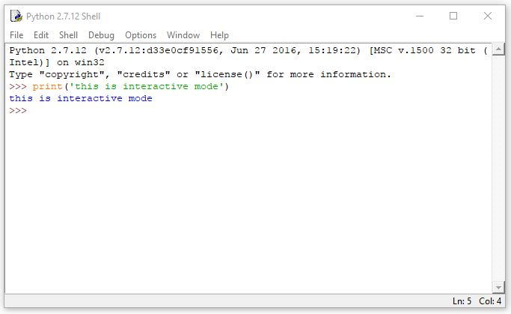
Python Overview
Version 3.9
Python is an object-oriented language
Easy to learn and read
Interactive mode
Command Line
Large variety of libraries
Image processing
Plotting
GUI Programming
Built-In IDE (IDLE)
Notes:
Jackie

Slide 4
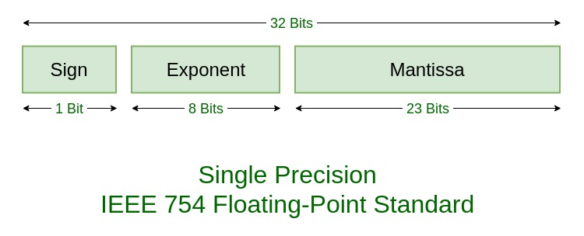
Basic Data Types
Numerical
Integers
Non-fractional numbers
-2, -1, 0, 1, 2
Float
Floating point numbers
Numbers with a fractional component
If you’ve taken CMPEN 270 you already hate them
Notes:
Will

Slide 5
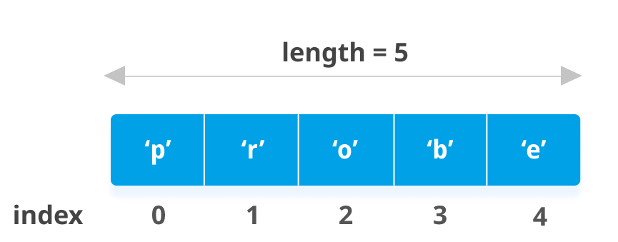
Basic Data Types
Sequences
List
Sequence of elements
Denoted with []
Get elements with indices
Tuple
Less common
Denoted with ()
Like a list, but you can’t change it after it has been declared
Notes:
Will

Slide 6
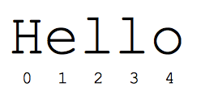
Basic Data Types
Other important types
String
Collection of characters
Denoted with “x” or ‘x’
Can be treated as a python list of characters
Bool
True or False
Boolean values must be capitalized
“True” good
“true” bad
Notes:
Will

Slide 7
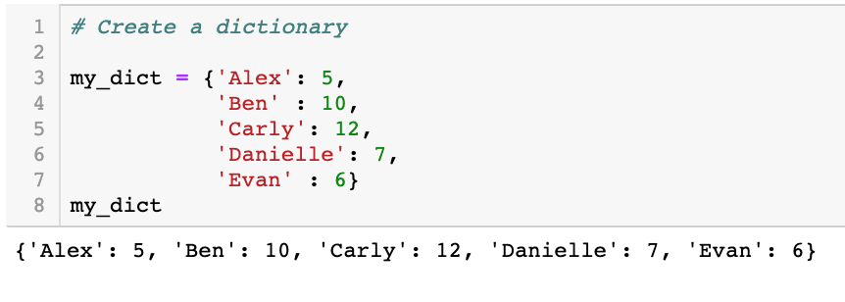
Basic Data Types
Some other python data types
Dict
Complex
Range
Byte
And more!
Notes:
Will

Slide 8
Python Syntax
Basics
Comments
Python will skip any line that starts with a #
Triple quotes can be used for multi-line
Variables
Python is not statically typed
Declare variables with =
Naming
Cannot start with a number
Can only contain A-z, 0-9, and _
#declare x as a float
x = 3.14
#declare x as a string
x = “hello world”
#declare x as a list
x = [3.14, “hello world”, True]
#and so on...
Notes:
Will

Slide 9
Python Syntax
Conditionals
Python can compare values with <, >, <=, >=, !=, and ==
Returns True or False
if-elif-else
Python does not use {}
The code that you want the statement to run should be indented on the next lines
x = 5
y = 10
if x > y:
print(“x is bigger”)
elif 2 != 3:
print(“2 is not 3”)
else:
#something else...
Notes:
Will

Slide 10
Python Syntax
Loops
While
while (condition):
For
for (variable) in (iterable):
#do something forever
while True:
print(“python”)
#print the numbers 0-9
for i in range(10):
print(i)
#print the elements in a list x
x = [“python”, “java”, “c++”]
for j in x:
print(j)
Notes:
Will

Slide 11
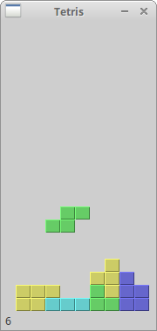
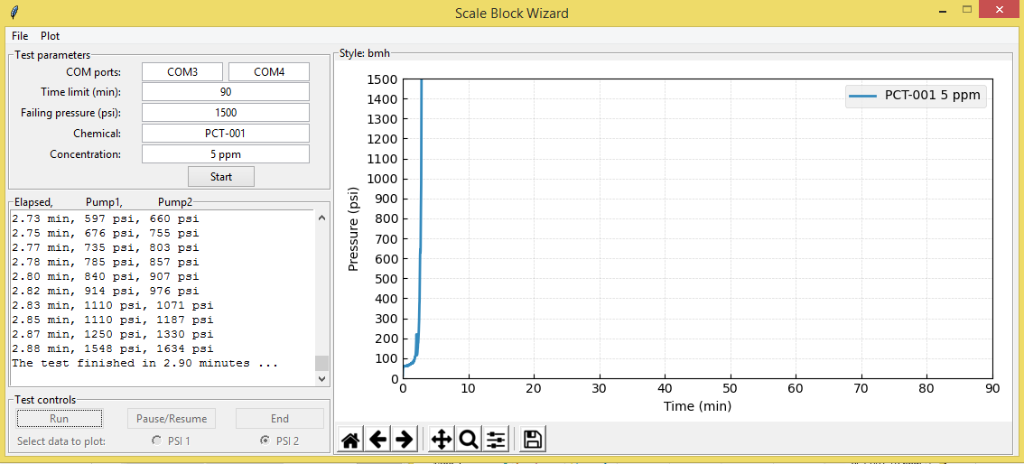
What can you do with Tkinter
Notes:
http://zetcode.com/wxpython/thetetrisgame/

Slide 12
Tkinter Terminology and Coding
Coding in tkinter involves straightforward layering
Initialize tkinter (import, set up class/constructor)
Create widget
Pack Widget
Create main loop
This can get more advanced if you want multiple frames
You can also layer widgets within widgets
Widget: Standard GUI elements (buttons, menus, labels, entries, etc)
Pack: Method used to specify positioning of widgets within their container (left, right, top, bottom)
Frame: A widget used to contain other widgets, so that you can organize your GUI the way you want

Slide 13
Basic Tkinter Example
#tkinter is a native library to python, but you must import it to use it
import tkinter as tk
#instantiate tkinter class
root = tk.Tk()
#create widget
label = tk.Label(root, text = ‘Hello World’, padx=10, pady=10)
#pack widget
label.pack()
#create main loop
root.mainloop()

Slide 14
Making a GUI Aesthetic
When making a GUI you may wish to change font color, size, etc
fg: foreground (text) color
bg: background color
bd: background size
font: font style of the text
size: size of text
Lists of available colors and fonts can be found online
Example:
label = tk.Label(root,
text = ‘Merry Christmas’,
fg = ‘red’
bd = 5
bg = ‘green’
font = (‘arial’, size = 10))

Slide 15
A more layered example...
import tkinter
#create the class and constructor
class ExampleGUI:
def __init__(self):
#create frames
self.frame1 = tkinter.Frame()
self.frame2 = tkinter.Frame()
#frame1 widgets
self.title = tkinter.Label(self.frame1, text = ‘Example’, bd = 15, bg = ‘blue’, fg = ‘red’, font = (‘arial’, 15))
#pack frame1 widgets into frame1
self.title.pack()
#frame2 widgets
self.prompt = tkinter.Label(self.frame2, text=’Enter your name:’)
self.nameEntry = tkinter.Entry(self.frame2, width = 10)
#pack frame2 widgets into frame2
self.prompt.pack()
self.nameEntry.pack()
#pack frames into main window
self.frame1.pack()
self.frame2.pack()
#enter main loop
tkinter.mainloop()
#create instance of ExampleGUI
example = ExampleGUI()

Slide 16
How about something functional?
Most programs you write should be interactive
Take an input → Show an output
We’ll create a program for taking notes / ‘To-do’ list
Use what we’ve learned so far + advanced features
Notes:
Ethan

